Slide 1

Presentation on Temperature SENSOR
13/10/2021

Slide 2
Key Takeaway
LM35 Sensor
PIC16F877A Microcontroller
Circuit Diagram
Schematic on Proteus Suite
Code
Materials Required
Project Overview

Slide 3
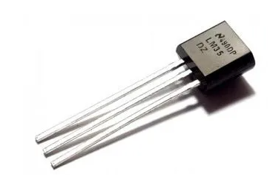
LM35
The LM35 is a semiconductor temperature sensor with three pin connection (VCC INP, OUT and GROUND) which operates from 4 Volt to 30 Volt ,with an output voltage linearly related to Centigrade temperature. Since the LM35 output varies with dependent to the temperature we need 12 bit ADC (Analog-to-Digital Converter) module to measure this voltage. The ADC module converts analog data into digital data and display it on the LCD LM016L screen.
Key Features:
Output Voltage: 10mV/°C (meaning for every 1°C increase in temperature, the output voltage increases by 10mV).
Operating Range: -55°C to 150°C (LM35) or -40°C to 110°C (LM35C)
Supply Voltage: 4V to 30V
Low Power Consumption: Typically less than 60µA
Low Output Impedance: 0.1Ω for 1mA load
Applications:
Industrial Automation: Monitoring temperatures in various industrial processes.
Home Appliances: Controlling temperature in refrigerators, ovens, and air conditioners.
Automotive Systems: Monitoring engine temperature and other critical temperatures.
LM35 Temperature Sensor

Slide 4
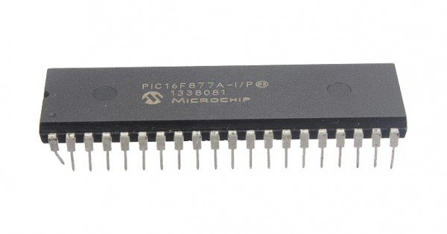
PIC16F877A
The PIC16F877A is a popular 8-bit microcontroller from Microchip Technology. It's widely used in various embedded systems and electronic projects due to its versatility, affordability, and ease of use.
Key Features:
8-bit Microcontroller: It has a powerful 8-bit Harvard architecture CPU.
Flash Memory: 8K words of Flash memory for storing the program code.
Data Memory: 368 bytes of RAM for storing data.
Applications:
Embedded Systems: Industrial automation, home appliances, automotive systems, and more.
Robotics: Controlling robot movements, sensors, and actuators.
IoT Devices: Building smart home devices, wearable technology, and industrial IoT solutions.
Fig : PIC16F877A Microcontroller

Slide 5
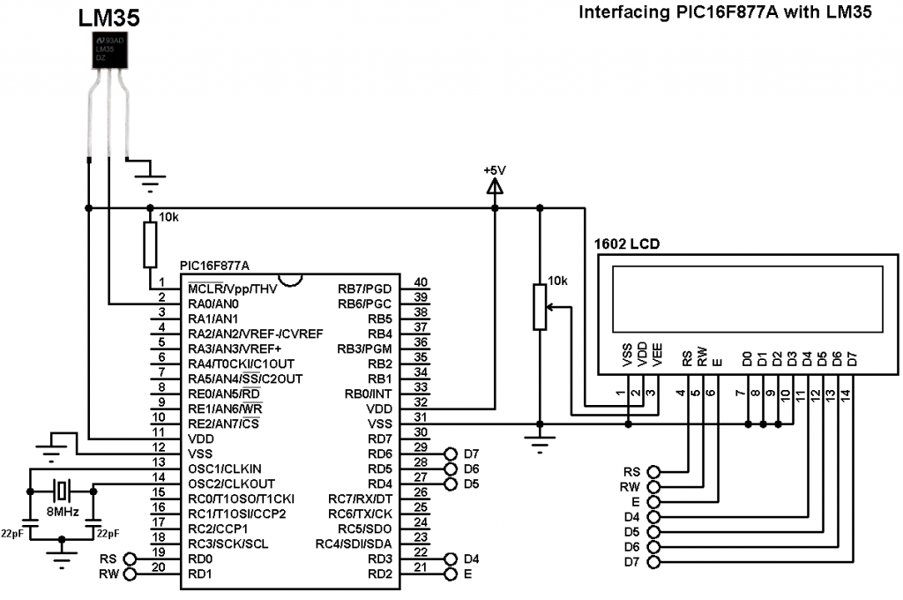
Main Figure Of LM35 Sensor Interface With PIC16F877A Microcontroller And LCD Display.

Slide 6
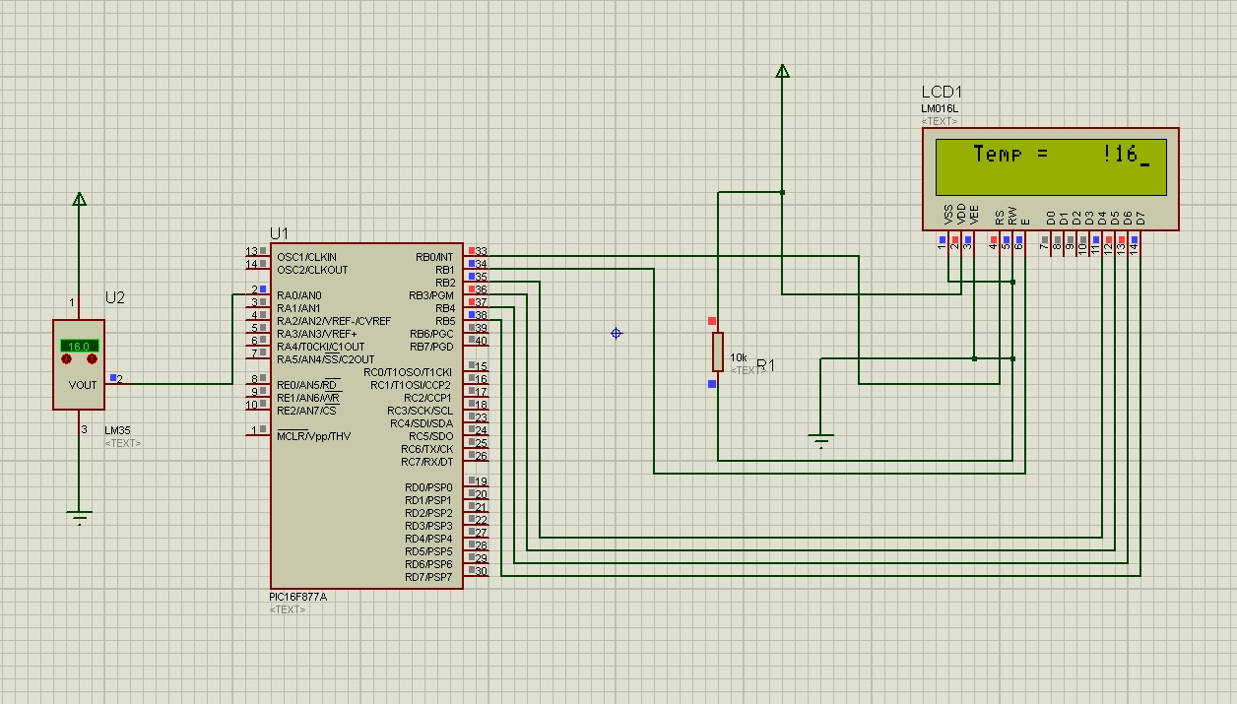
Simulation OF LM35 Sensor Interface With The PIC16F877A Microcontroller And Display the Output. The Circuit Was Designed In Proteus Suite

Slide 7
Here It Shows The Programming Step By Step, The Code Was Written In mikroC
// Lcd pinout settings
sbit LCD_RS at RB0_bit;
sbit LCD_EN at RB1_bit;
sbit LCD_D7 at RB5_bit;
sbit LCD_D6 at RB4_bit;
sbit LCD_D5 at RB3_bit;
sbit LCD_D4 at RB2_bit;
// Pin direction
sbit LCD_RS_Direction at TRISB0_bit;
sbit LCD_EN_Direction at TRISB1_bit;
sbit LCD_D7_Direction at TRISB5_bit;
sbit LCD_D6_Direction at TRISB4_bit;
sbit LCD_D5_Direction at TRISB3_bit;
sbit LCD_D4_Direction at TRISB2_bit;
int vref = 5 ; // its applied voltage change if 3.3 or 3.7 etc
int tmp; // initialize variable int as tmp
int temp_celcius;
char tmp1[3]; // initialize char to store a string of 3 chars
void main() {
LCD_Init(); //Initializes the LCD modules
DElay_ms(250);
ADC_Init(); // Initializes the ADC Module for ADC Conversions
delay_ms(250);
LCD_OUT(1,1, " Temperature "); // LCD Will display at row 1 column 1 Learning.
LCD_OUT(2,2, "Sensor"); // LCD Will display at row column 2 Microcontrollers.
Delay_ms(3200); // Will display this for 2 seconds
Lcd_Cmd(_LCD_CLEAR); // Will clear LCD for new values to be displayed
while(1) // Needed for operations its an internal loop which keeps on executing
{
tmp = ADC_Read(0); // ADC read from pin AN 0
delay_ms(50);
temp_celcius = ( tmp * vref )/ 10 ;
delay_ms(20);
IntToStr(temp_celcius, tmp1); // will convert values of tmp to tmp1
delay_ms(20);
// Now we can display this string on LCD
Lcd_Cmd(_LCD_CLEAR); // Precaution clear for readings to be displayed
LCD_OUT(1,1, "Temp = ");
LCD_OUT(1,10,tmp1); // I changed column number to display result after above helping string
Delay_ms(800); // Keep displaying same value for 0.5 sec
Lcd_Cmd(_LCD_CLEAR); // Then clear LCD for new values
}
}
LM35 Temperature Sensor Data Sheet

Slide 8

Materials Required To Construct The Device
PicKit 3
LM35 Temperature Sensor
$16×2$ LCD
PIC16F877A IC
40 - Pin IC holder
Perf board
20 MHz Crystal OSC
Female and Male Bergstick pins
33pf Capacitor - 2Nos, 100uf and 10uf cap.
680 ohm, 220 ohm, 10K and 560ohm Resistor
Potentiometer 10k
LED of any color
1 Soldering kit
IC 7805
5V Adapter
12 bit Analog to Digital Converter
Connecting wires
Breadboard

Slide 9
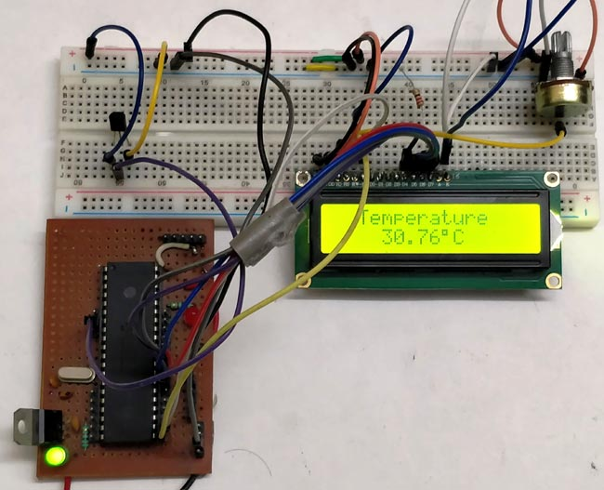
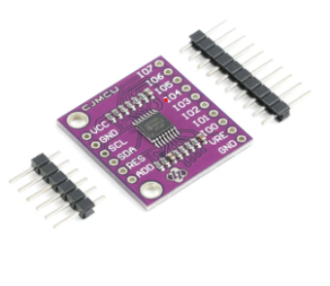

Device Overview
Analog to Digital Thermometer using LM35 and PIC microcontroller. If any heat or cold source are bought near the sensor, the LCD will show readings in degree Celsius from (- ${55}^{0}$ to +${150}^{0}$) by dual supply and (+$2^{0}$ to +${150}^{0}$ ) single supply.
It can be use in Microwave, Car Engine, Main Frame Computer, Refrigerators, Induction motors in industries etc.
The main fact about this it is very cheap and easy to assemble. Building this instrument would cost around Six Hundred (600) Bangladeshi TAKA .
Fig : Psychical Mechanism
12 bit ADC Module

Slide 10



END of Slides
Imtiaz Hussain, ID-21008001
Spring 2021, EEE

